Slide 1
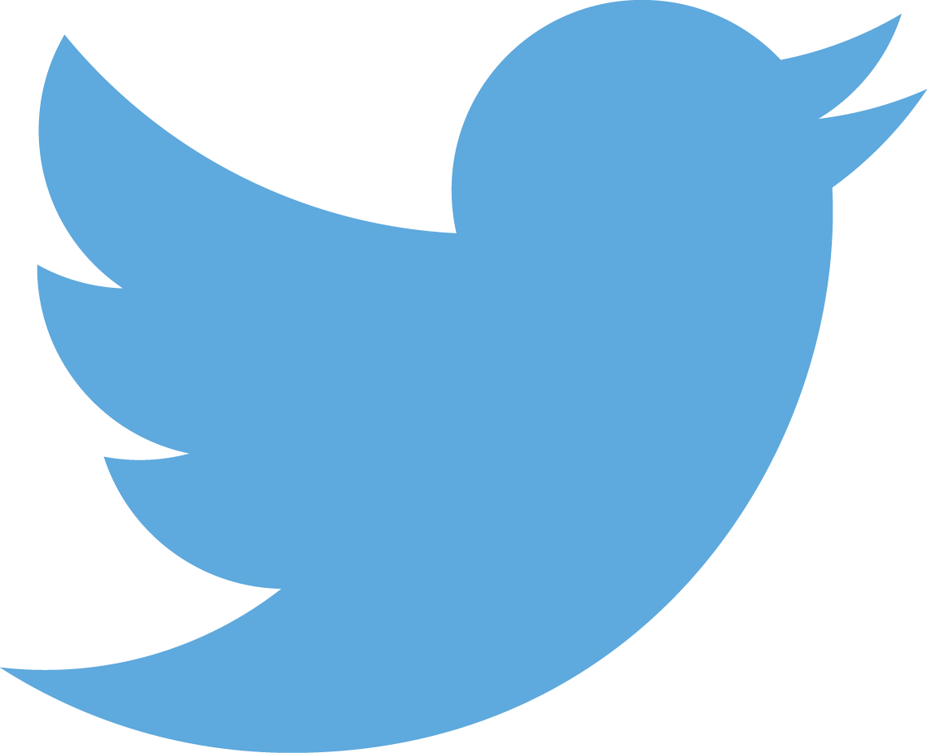
Python for PowerShell Users
Joshua Corrick
@JoshCorr

Slide 2
Story Time
Do you remember when you first learned how to use a bookmark?
Notes:
I don't, but I had the opportunity to see a child learn what a book mark was. The curiosity of kids is amazing.. What is that? Why are you doing that?
Like that a lot of us have learned PowerShell, or maybe we are learning PowerShell (or some other programing language), and we don't recall when we first learned what an object is, or even how a property, and method are different, but we probably had an oh that is how it works moment.
I find it easy to string those ideas into learning other things.
one day I will introduce them to web browser bookmarks (if they are still a thing) and he has a working framework of how things work.
Use Associative Learning
So what? Why bring this up?
It is a method of learning. Taking something we know and understanding something different
Python is a strong canidate of a language to diversify your skills, and can be easily understood

Slide 3

whoamI
Josh Corrick (@joshCorr)
Production Systems Engineer
PowerShell tool maker
Python Novice
Bookmark user

Slide 4
Where are we going?
Highlevel over view of powershell/python differences
Setup Python with pyenv
Use pip and pipx
Built-in Functions
Objects in Python
Writing your first Python script

Slide 5
Quick Facts
Started by Guido Van Rossum as a hobby.
2 major versions Python2 and Python3
Easy-to-read syntax
Large standard library of functions
Runs everywhere (Linux, Apple, Windows, Unix)
🤔

Slide 6
Differences
PoweRShell
Python
Case Insensensitive
Spaces don't matter
Formatting doesn't really matter
Mostly interacitve functions
Modules
Case Sensitive
Spaces matter a lot
Formatting should be Zen
Mostly libraries used in Scripts
Module and Packages
Notes:
The Zen of Python, by Tim Peters
Beautiful is better than ugly.
Explicit is better than implicit.
Simple is better than complex...
Modules, single file. Packages are a bunch of modules with special files __init__.py for loading submodules

Slide 7
INSTALLATIon
Python on Windows
Install from the Microsoft Store
MSI installer
Docker
Create a Linux VM
Installing with WSLv2

Slide 8
DEMO
Setup Python

Slide 9
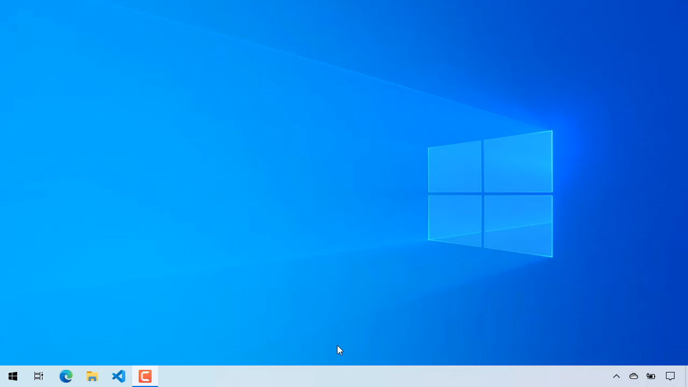

Slide 10
DEMO
Setup Python

Slide 11
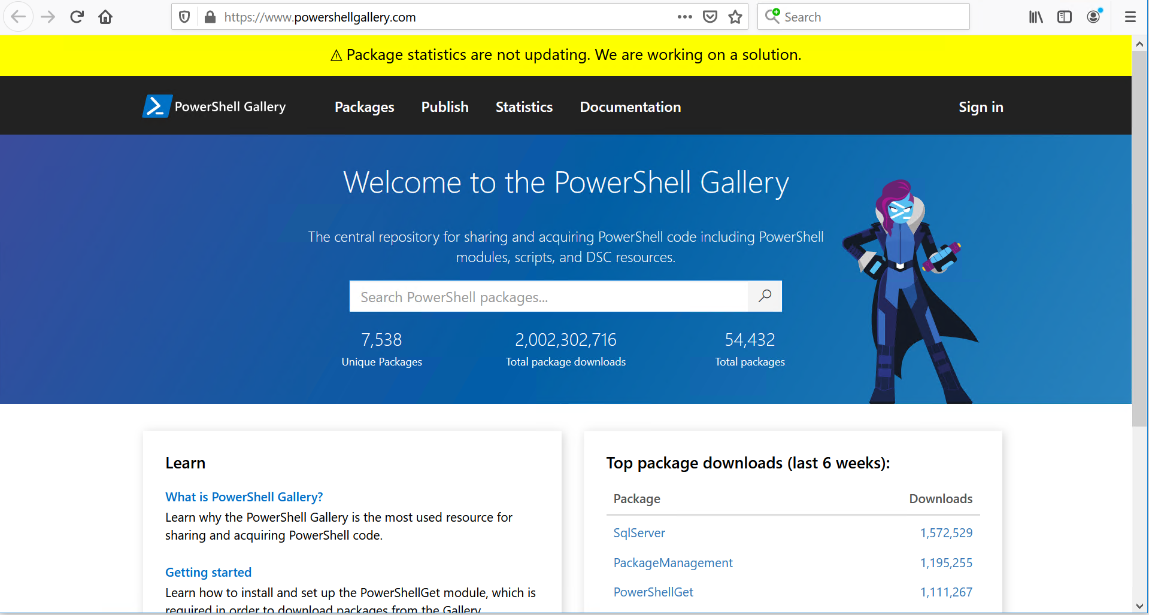
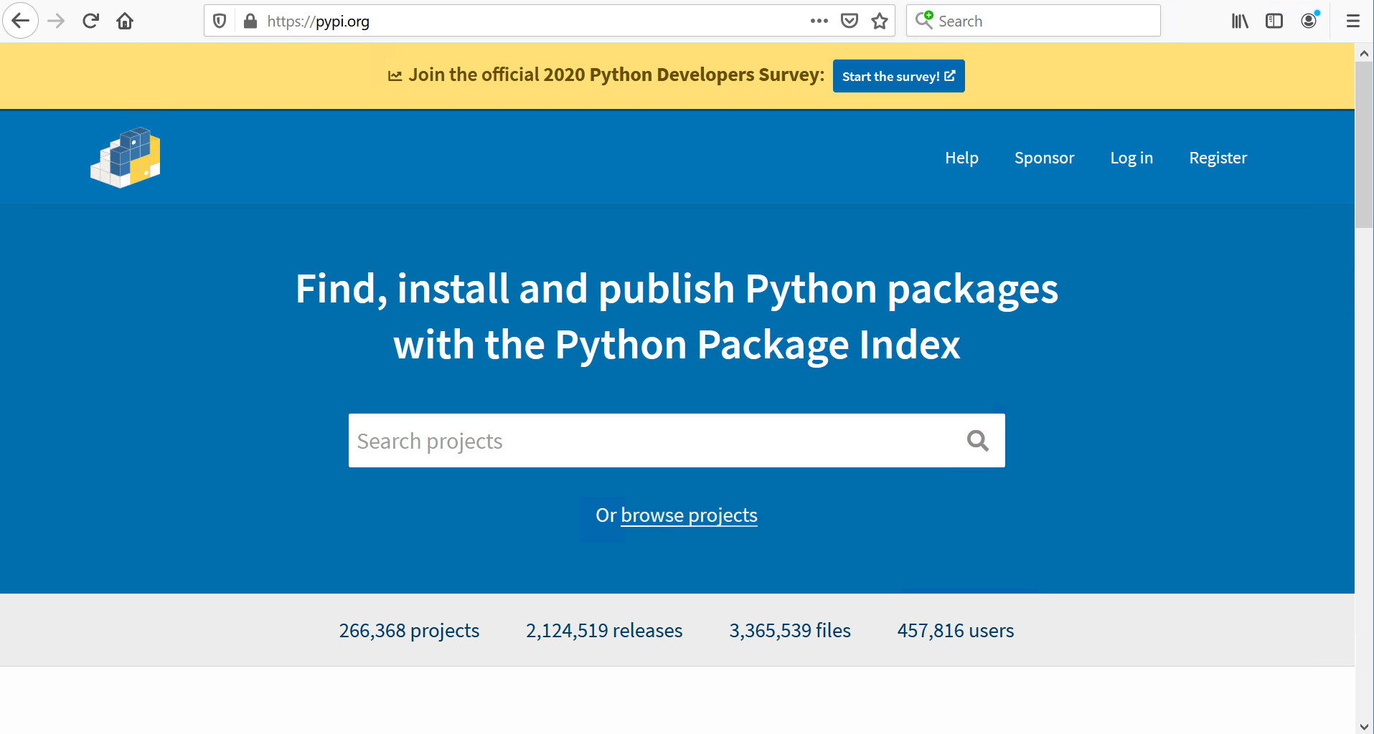
Modules & Packages
Notes:
Pypi – short for Python Package Index; Alternatives like https://gemfury.com/l/pypi-server, ProGet

Slide 12
DEMO
Setup Pip & Pipx

Slide 13
Differences
Pip
PipX
Used to install libraries and apps
From pypi (or private repo)
Use a venv (virtual environment)
or pip install –user <pacakge>
Typically installing to use in a project
Used to install python applications
From pypi (or private repo)
Creates a venv for the package
with pipx install <package>
https://pipxproject.github.io/pipx/

Slide 14
Demo
Let's look at some code!!

Slide 15
Take awaYs

Slide 16
resources
PowerShell Guide to Python – Prateek Singh - https://leanpub.com/PowerShell-to-Python
Hitchhickers Guide to Python - https://docs.python-guide.org/
Learn X in Y - https://learnxinyminutes.com/docs/python/
Microsoft Learn - https://docs.microsoft.com/en-us/learn/modules/intro-to-python/
Adam Driscoll - https://blog.ironmansoftware.com/powershell-vs-python/

Slide 17
Resources
Setup Python with pyenv
https://github.com/pyenv/pyenv
https://github.com/pyenv/pyenv-installer
Setup Pip (venv), Pipx
https://chriswarrick.com/blog/2018/09/04/python-virtual-environments/
https://pipxproject.github.io/pipx/

Slide 18
Thanks
to the Devopsorg team!

